Slide 1
Artificial Neural Networks
Prof. Dr. A K M Akhtar Hossain
Dept. Of CSE, RU

Slide 2

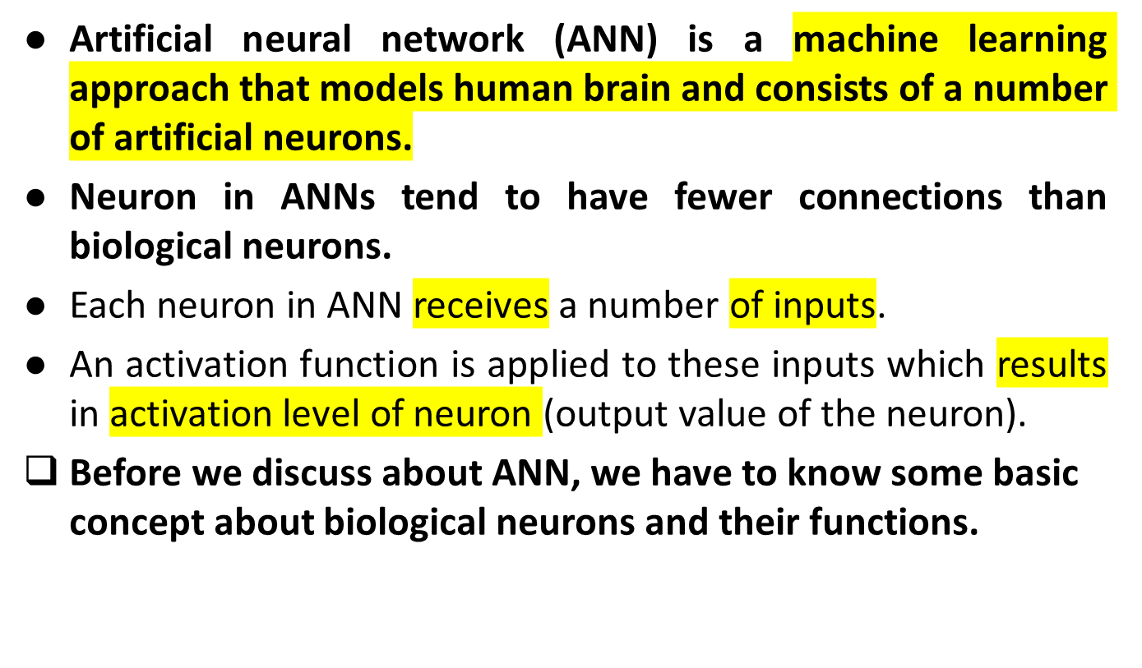
© Prof. Dr. A K M Akhtar Hossain Dept. of CSE, RU

Slide 3
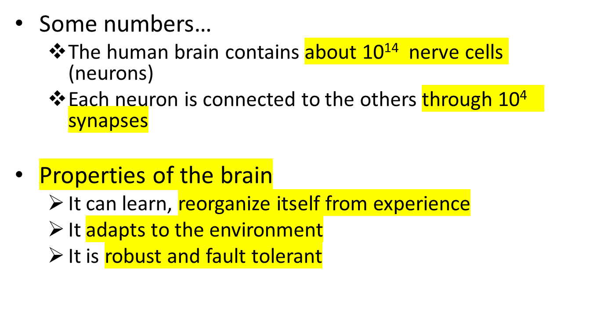
Biological inspirations
© Prof. Dr. A K M Akhtar Hossain Dept. of CSE, RU

Slide 4

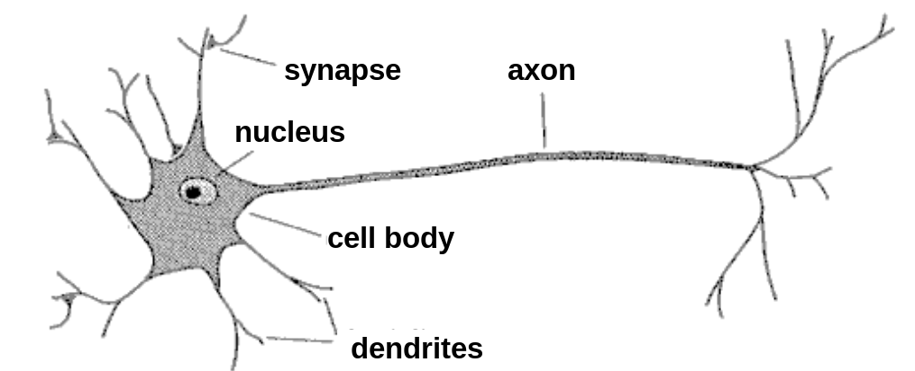
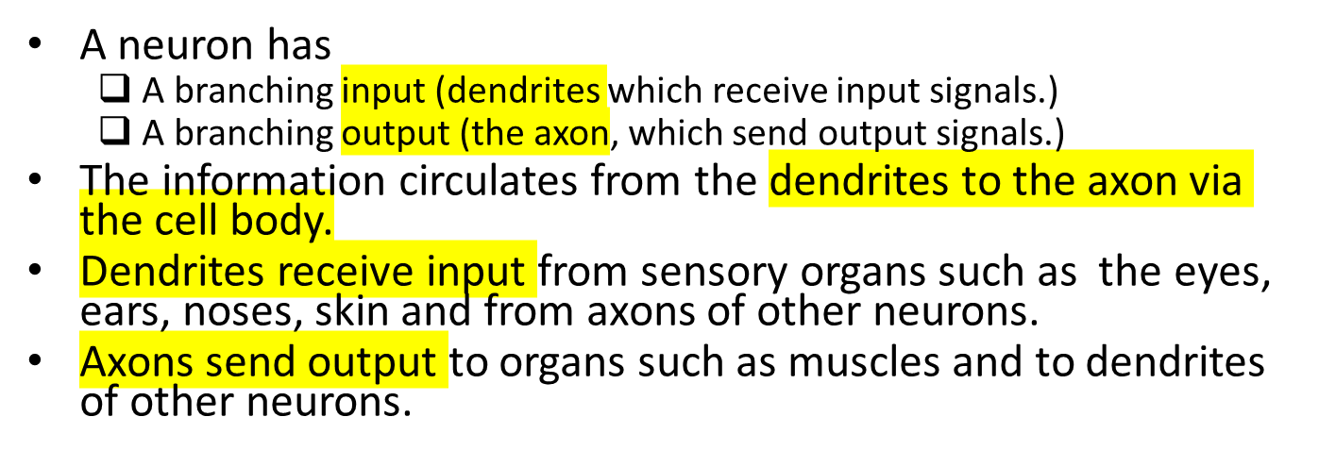
© Prof. Dr. A K M Akhtar Hossain Dept. of CSE, RU

Slide 5


An early attempt to form an abstract mathematical model of a neuron was by McCulloch and Pitts in 1943.
Their model …..
  receives a finite number of inputs x₁ , x₂, . . . . x_{M}
  Computes the weighted sum ,
  using the weights ω₁ , ω₂ , . . . . . ω_{M}
© Prof. Dr. A K M Akhtar Hossain Dept. of CSE, RU

Slide 6

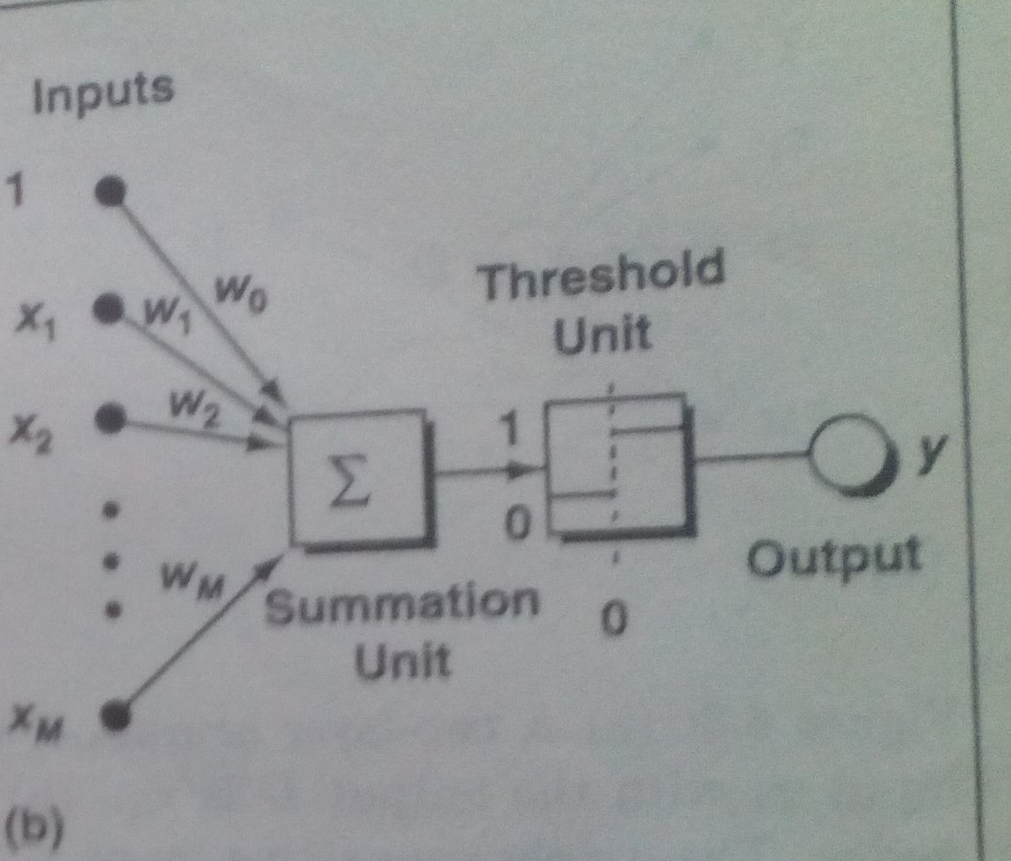

© Prof. Dr. A K M Akhtar Hossain Dept. of CSE, RU

Slide 7
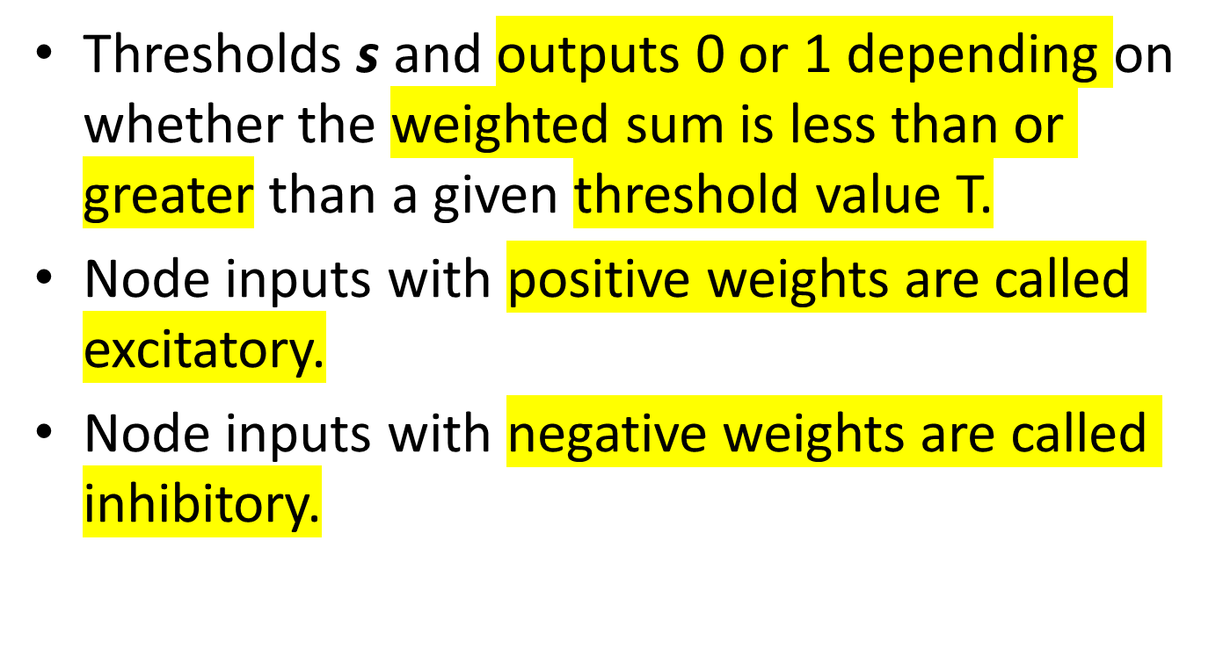
© Prof. Dr. A K M Akhtar Hossain Dept. of CSE, RU

Slide 8
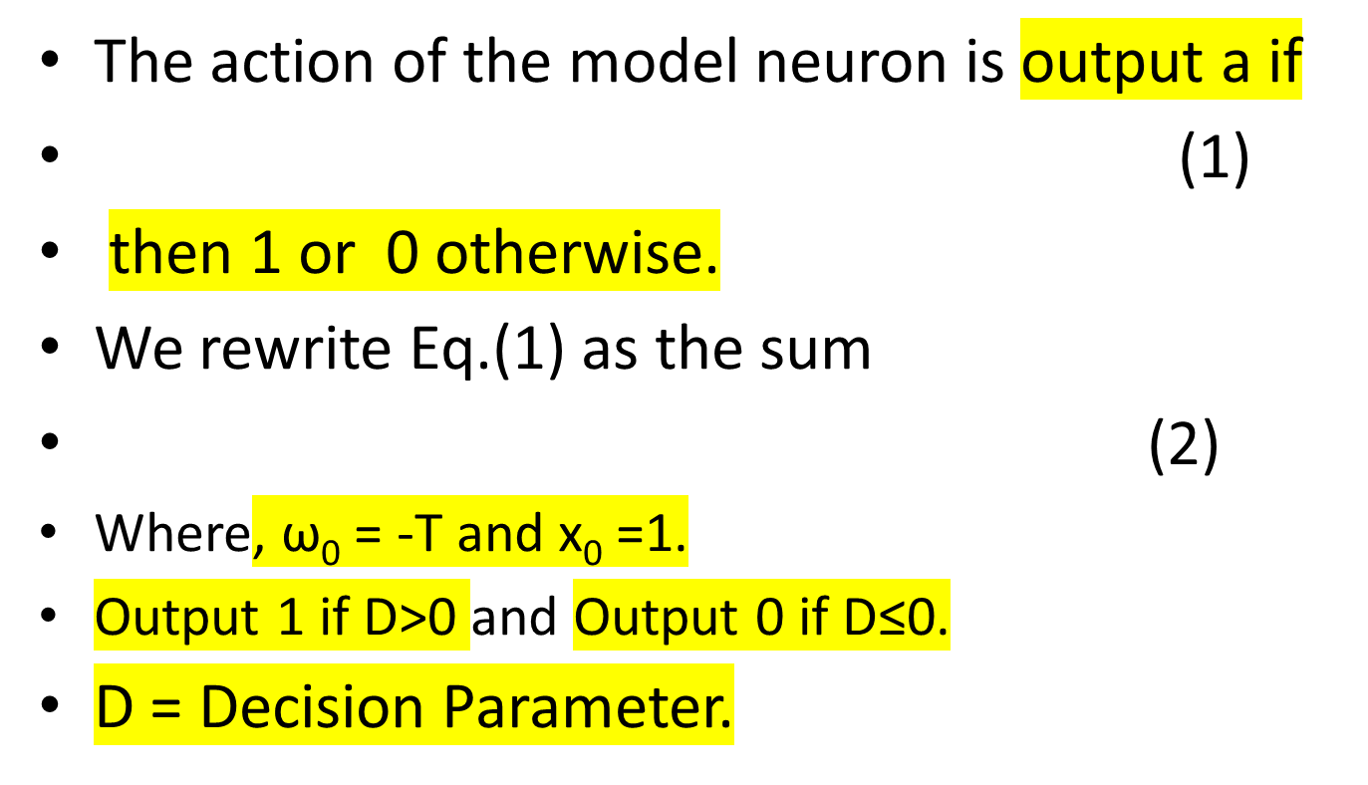
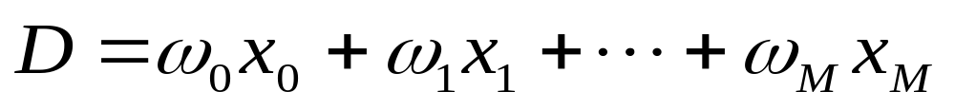
The McCulloch-Pitts model of the neuron
© Prof. Dr. A K M Akhtar Hossain Dept. of CSE, RU

Slide 9
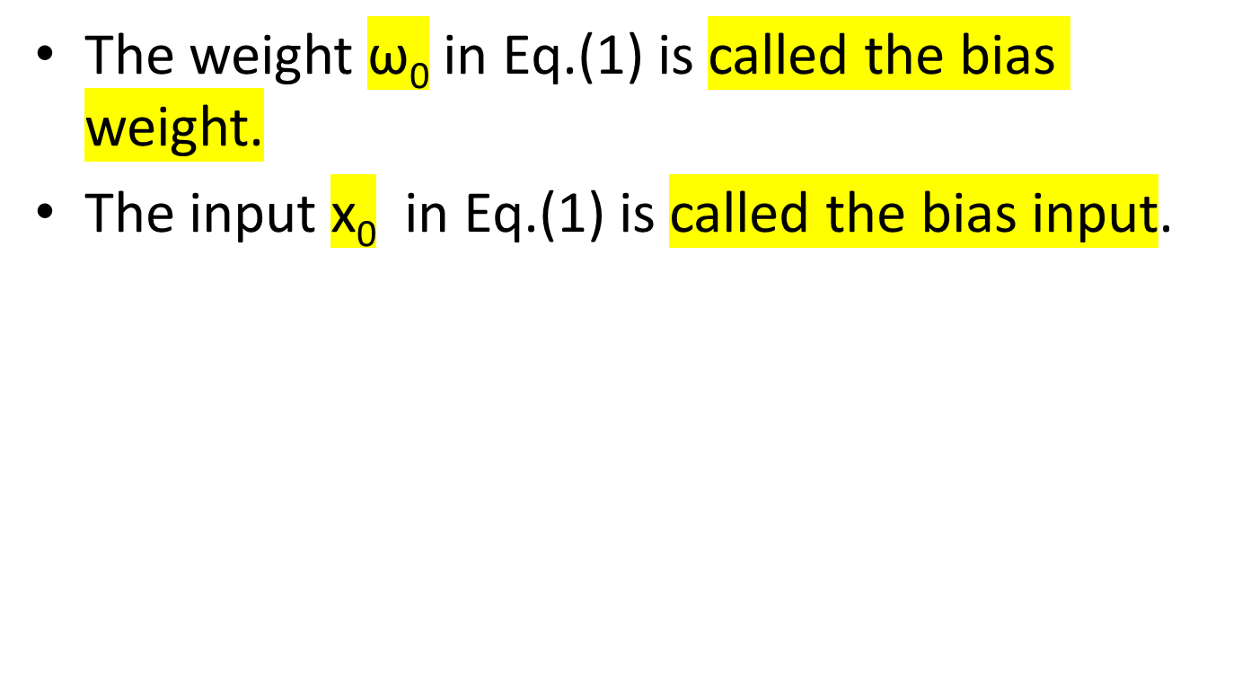
The McCulloch-Pitts model of the neuron
© Prof. Dr. A K M Akhtar Hossain Dept. of CSE, RU

Slide 10

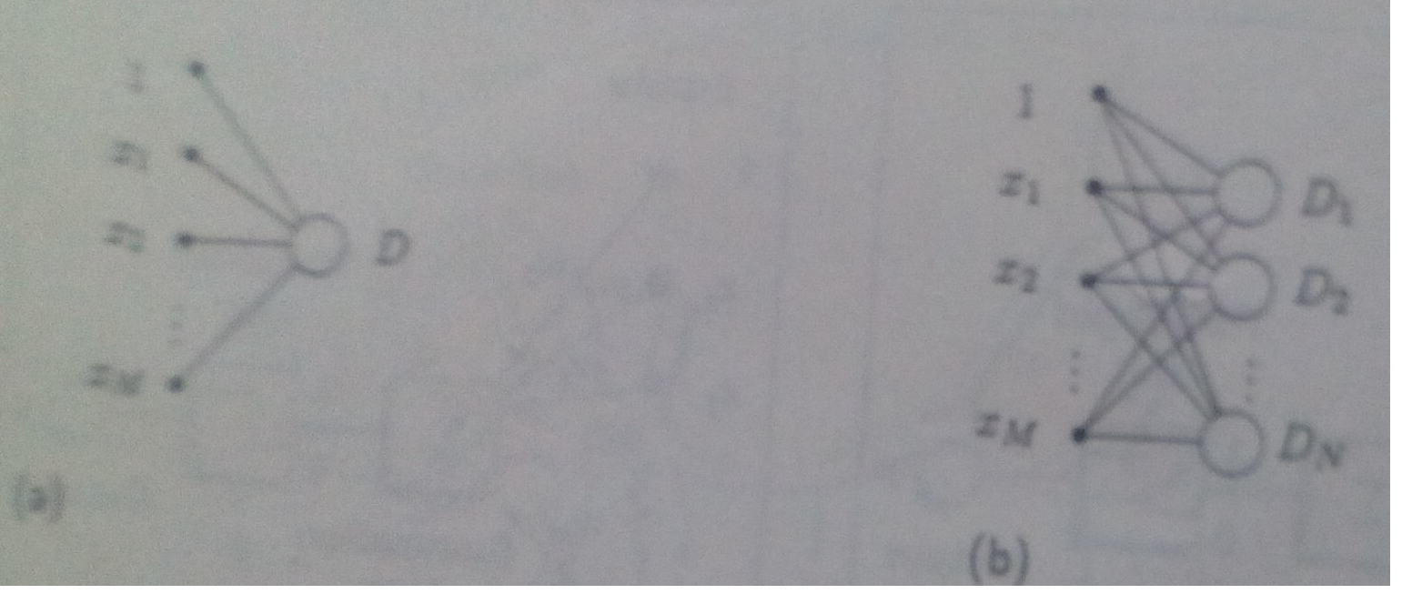
Figure(a). A two-layer neural net with one output. Fig.(b). A two-layer neural net with multiple output.
© Prof. Dr. A K M Akhtar Hossain Dept. of CSE, RU

Slide 11

Artificial neural network (ANN) is a machine learning approach that models human brain and consists of a number of artificial neurons.
Neuron in ANNs tend to have fewer connections than biological neurons.
Each neuron in ANN receives a number of inputs.
An activation function is applied to these inputs which results in activation level of neuron (output value of the neuron).
Knowledge about the learning task is given in the form of examples called training examples.
© Prof. Dr. A K M Akhtar Hossain Dept. of CSE, RU

Slide 12
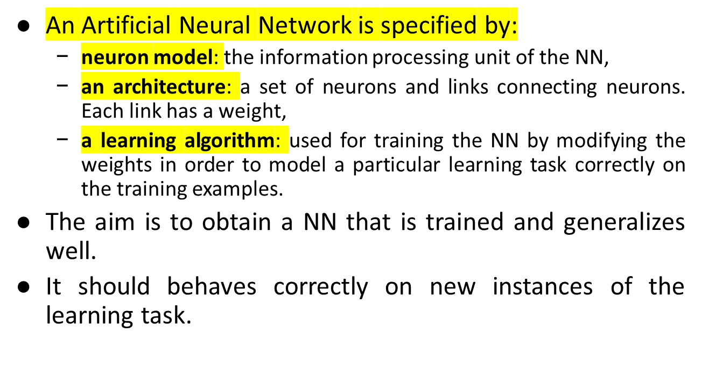
Contd..
© Prof. Dr. A K M Akhtar Hossain Dept. of CSE, RU

Slide 13

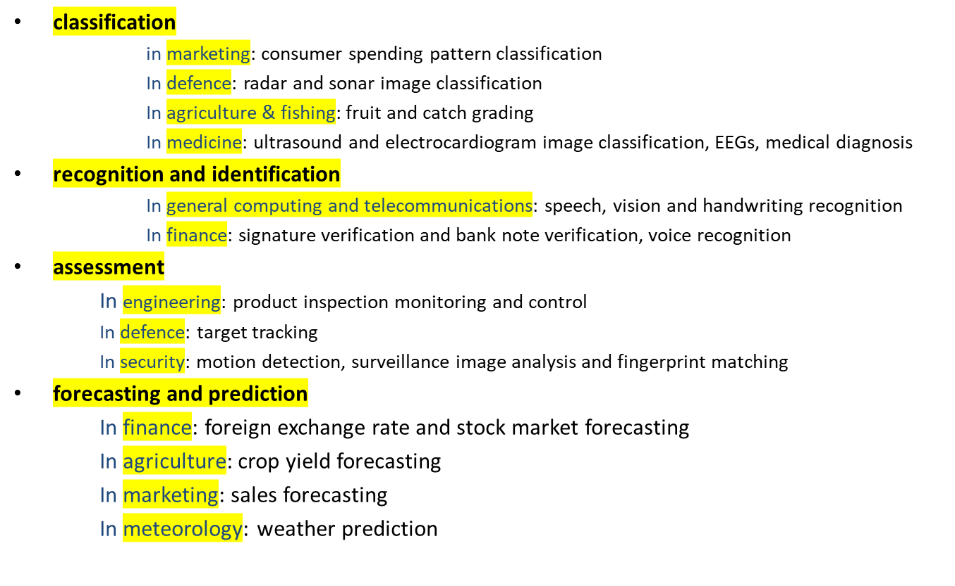
© Prof. Dr. A K M Akhtar Hossain Dept. of CSE, RU
Slide <number>

Slide 14

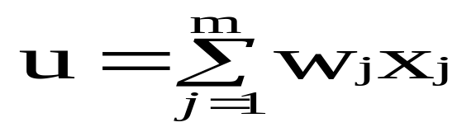

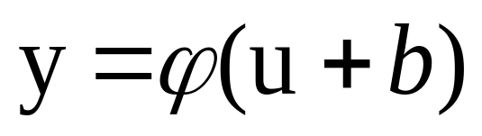
The neuron is the basic information processing unit of a NN. It consists of:
  A set of links, describing the neuron inputs, with weights W₁, W₂, …, W_{m}
  An adder function (linear combiner) for computing the weighted sum of the inputs:
  (real numbers)
  Activation function for limiting the amplitude of the neuron output. Here ‘b’ denotes bias.
© Prof. Dr. A K M Akhtar Hossain Dept. of CSE, RU

Slide 15


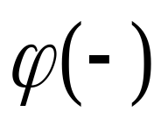

Bias
b
x₁
w₁
Activation
function
Induced
Field
v
Output
y
Input
values
x₂
w₂
Summing
function
x_{m}
w_{m}
weights
© Prof. Dr. A K M Akhtar Hossain Dept. of CSE, RU

Slide 16

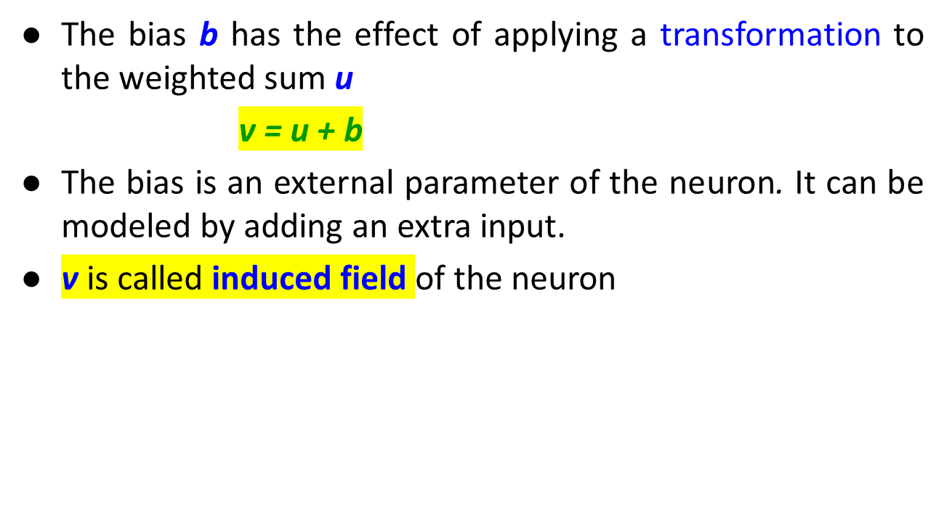
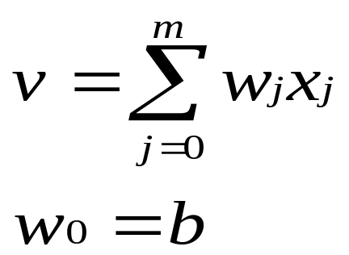
© Prof. Dr. A K M Akhtar Hossain Dept. of CSE, RU

Slide 17

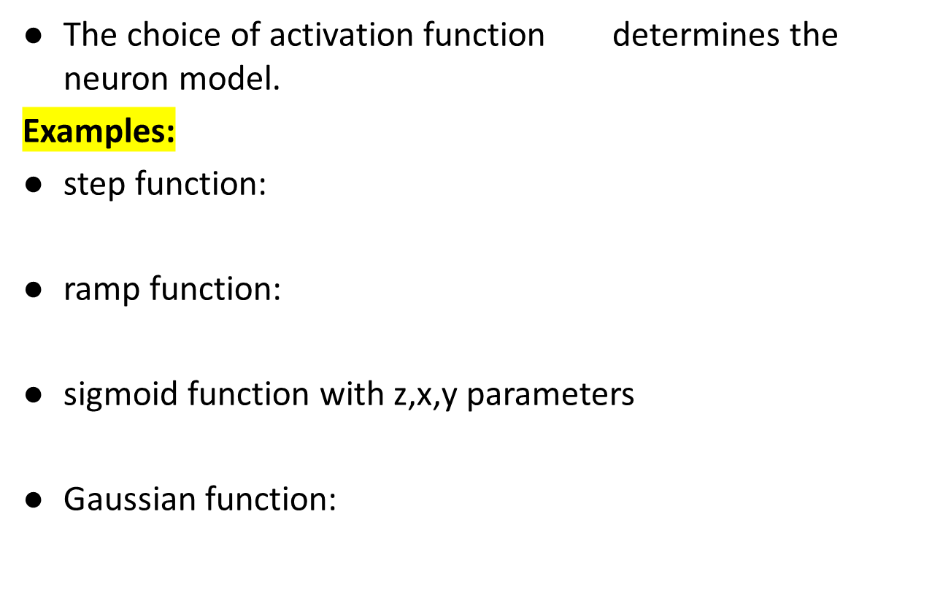
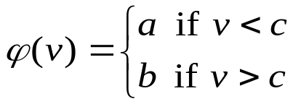
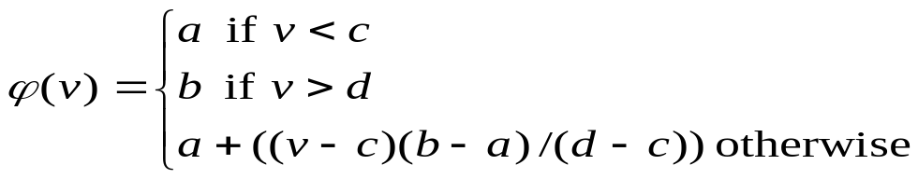
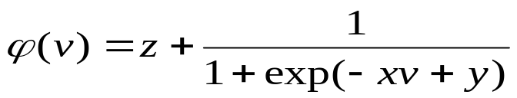
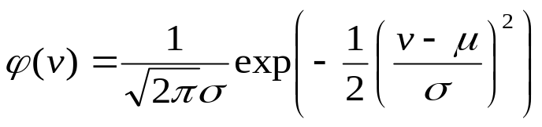
© Prof. Dr. A K M Akhtar Hossain Dept. of CSE, RU

Slide 18

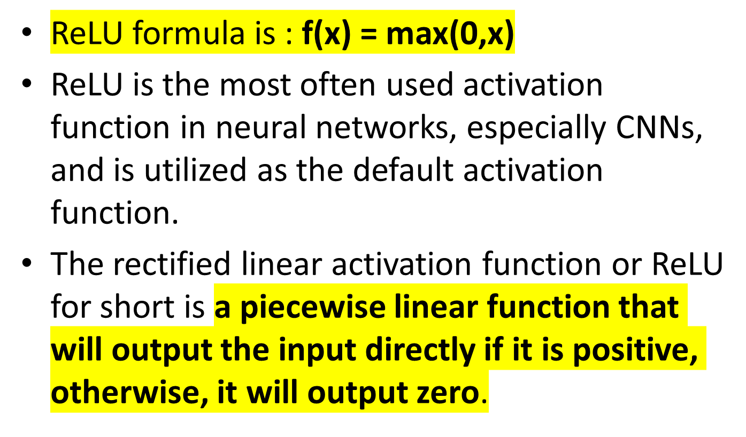
© Prof. Dr. A K M Akhtar Hossain Dept. of CSE, RU

Slide 19

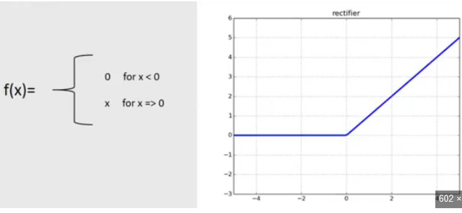
© Prof. Dr. A K M Akhtar Hossain Dept. of CSE, RU

Slide 20

b
a
c
© Prof. Dr. A K M Akhtar Hossain Dept. of CSE, RU

Slide 21

b
a
c d
© Prof. Dr. A K M Akhtar Hossain Dept. of CSE, RU

Slide 22

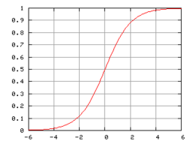
© Prof. Dr. A K M Akhtar Hossain Dept. of CSE, RU

Slide 23
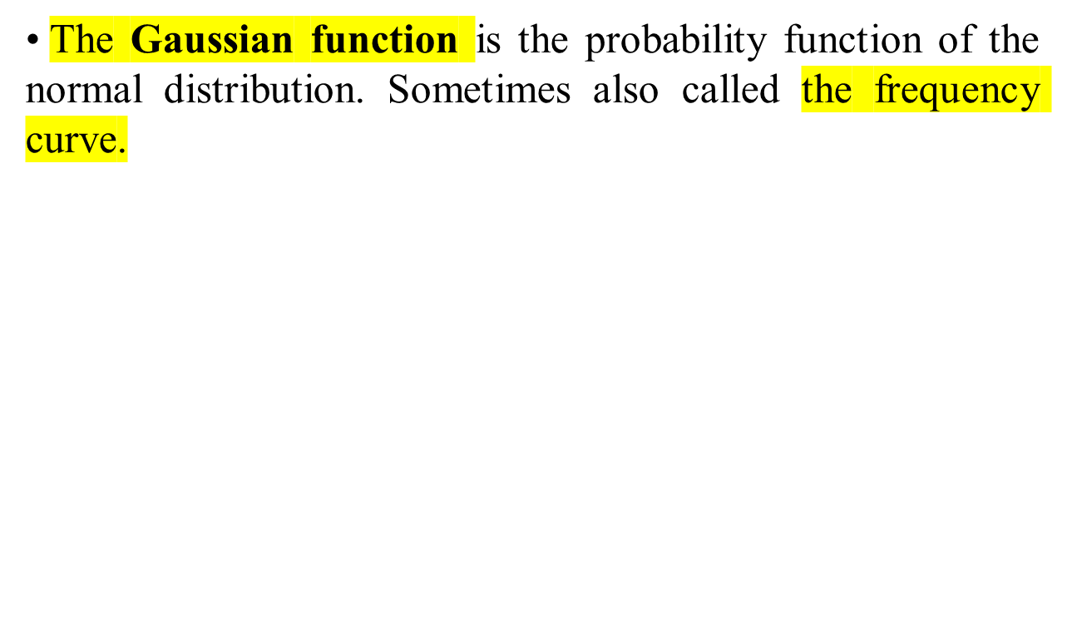

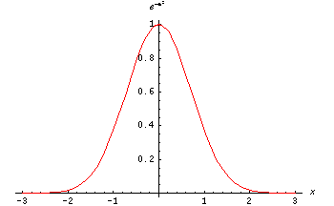
© Prof. Dr. A K M Akhtar Hossain Dept. of CSE, RU

Slide 24

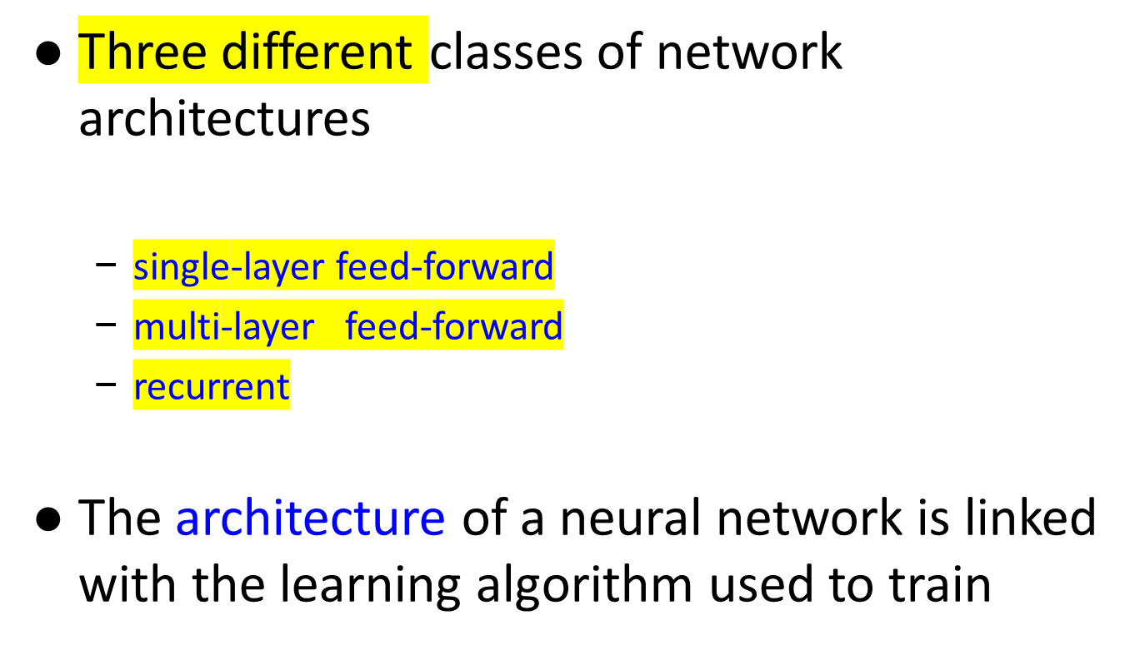
© Prof. Dr. A K M Akhtar Hossain Dept. of CSE, RU

Slide 25

Input layer
of
source nodes
Output layer
of
neurons
© Prof. Dr. A K M Akhtar Hossain Dept. of CSE, RU

Slide 26
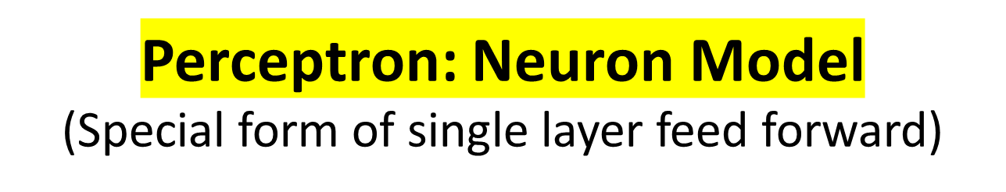

The perceptron was first proposed by Rosenblatt (1958) is a simple neuron that is used to classify its input into one of two categories.
A perceptron uses a step function that returns +1 if weighted sum of its input ≥ 0 and -1 otherwise
b (bias)
x₁
w₁
v
y
x₂
w₂
ϕ(v)
w_{n}
x_{n}
© Prof. Dr. A K M Akhtar Hossain Dept. of CSE, RU

Slide 27

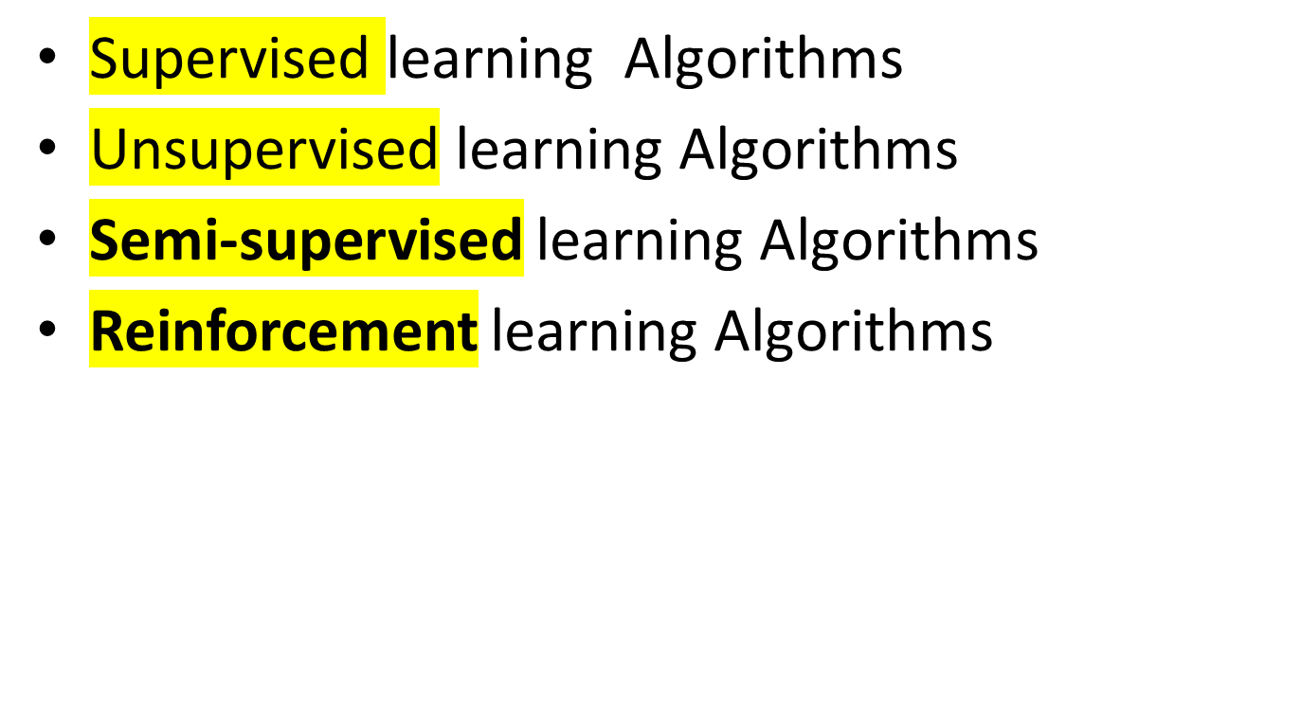
© Prof. Dr. A K M Akhtar Hossain Dept. of CSE, RU

Slide 28

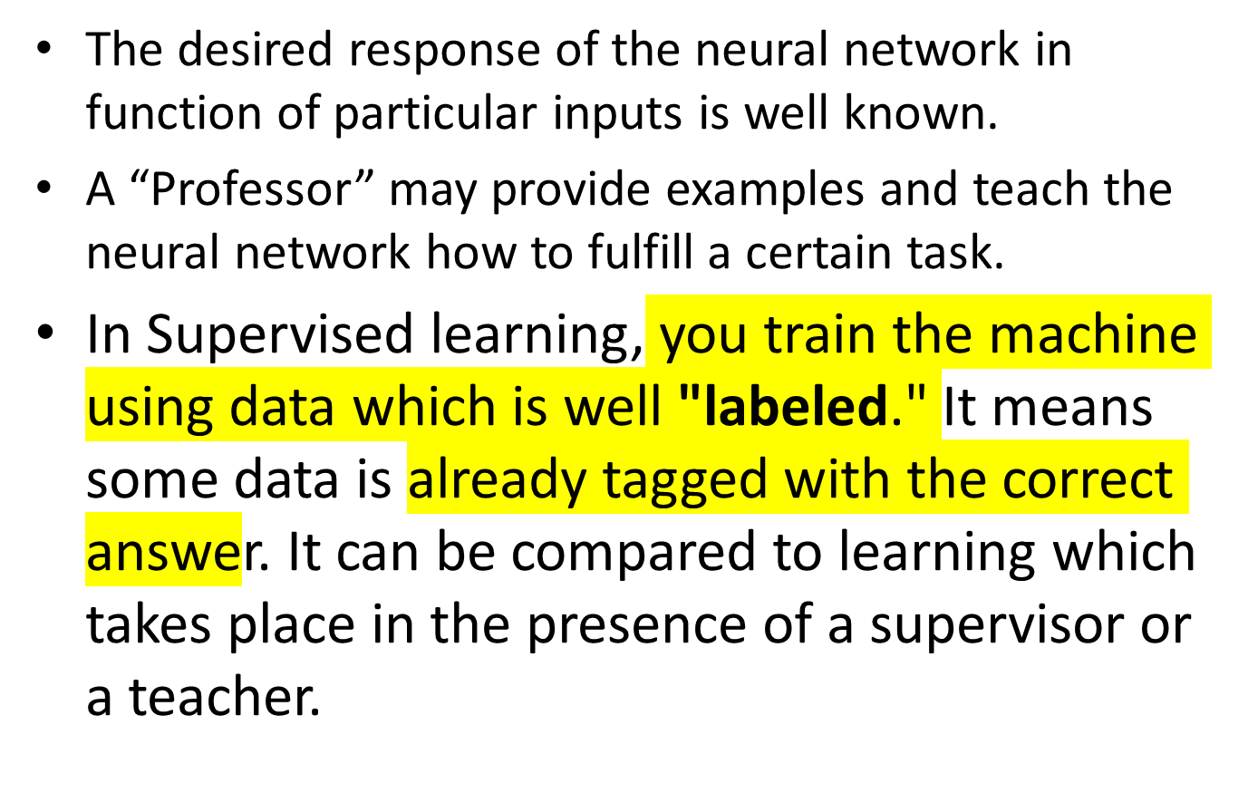
© Prof. Dr. A K M Akhtar Hossain Dept. of CSE, RU

Slide 29
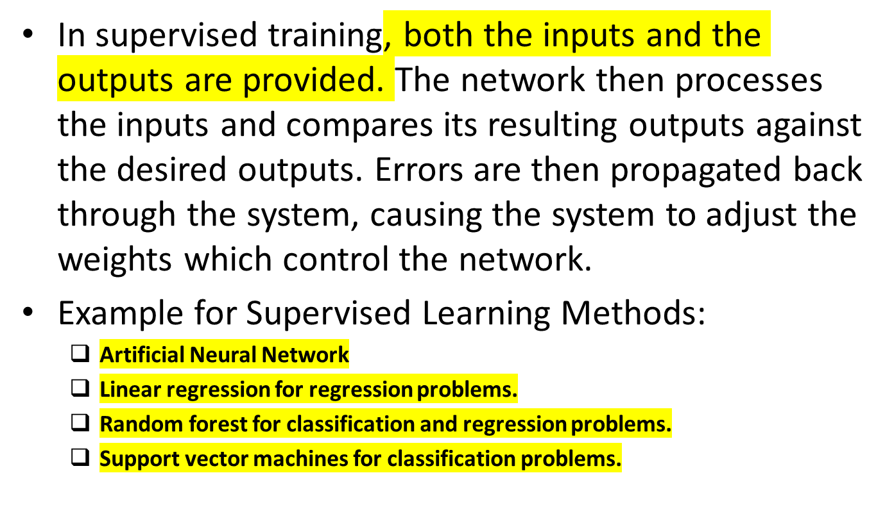
© Prof. Dr. A K M Akhtar Hossain Dept. of CSE, RU

Slide 30

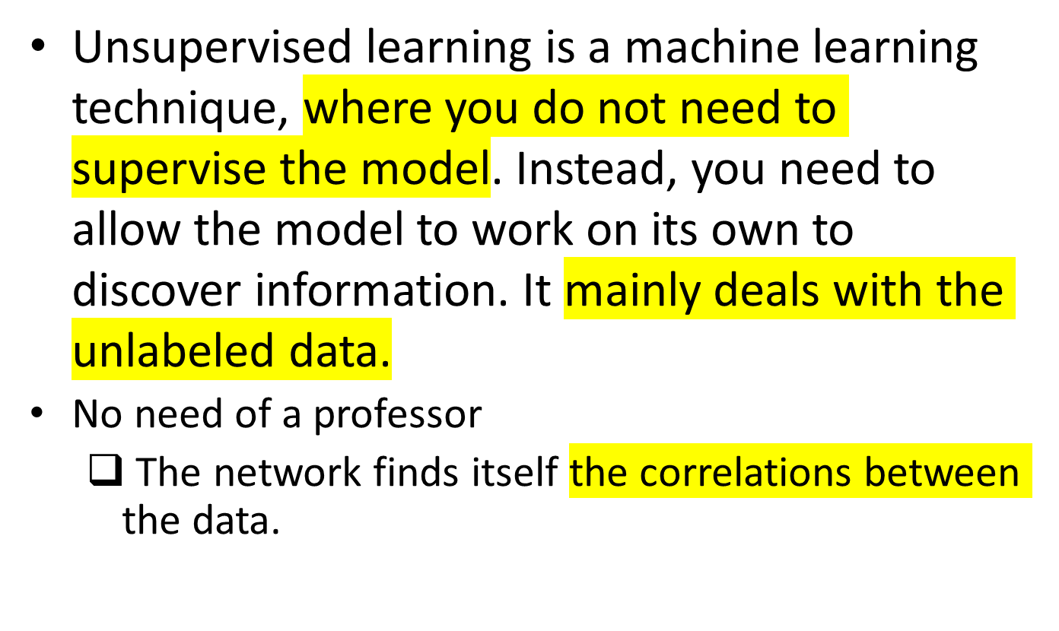
© Prof. Dr. A K M Akhtar Hossain Dept. of CSE, RU

Slide 31

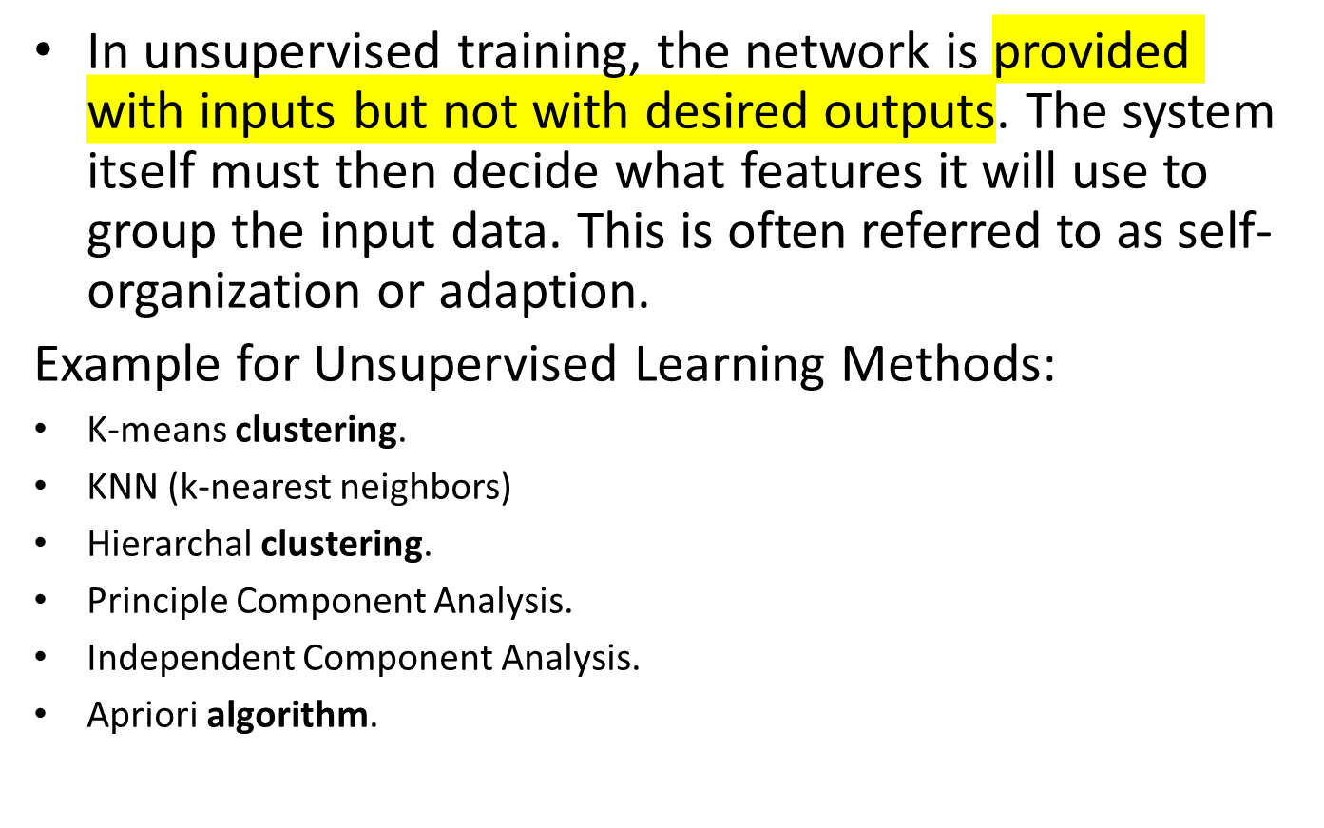
© Prof. Dr. A K M Akhtar Hossain Dept. of CSE, RU

Slide 32

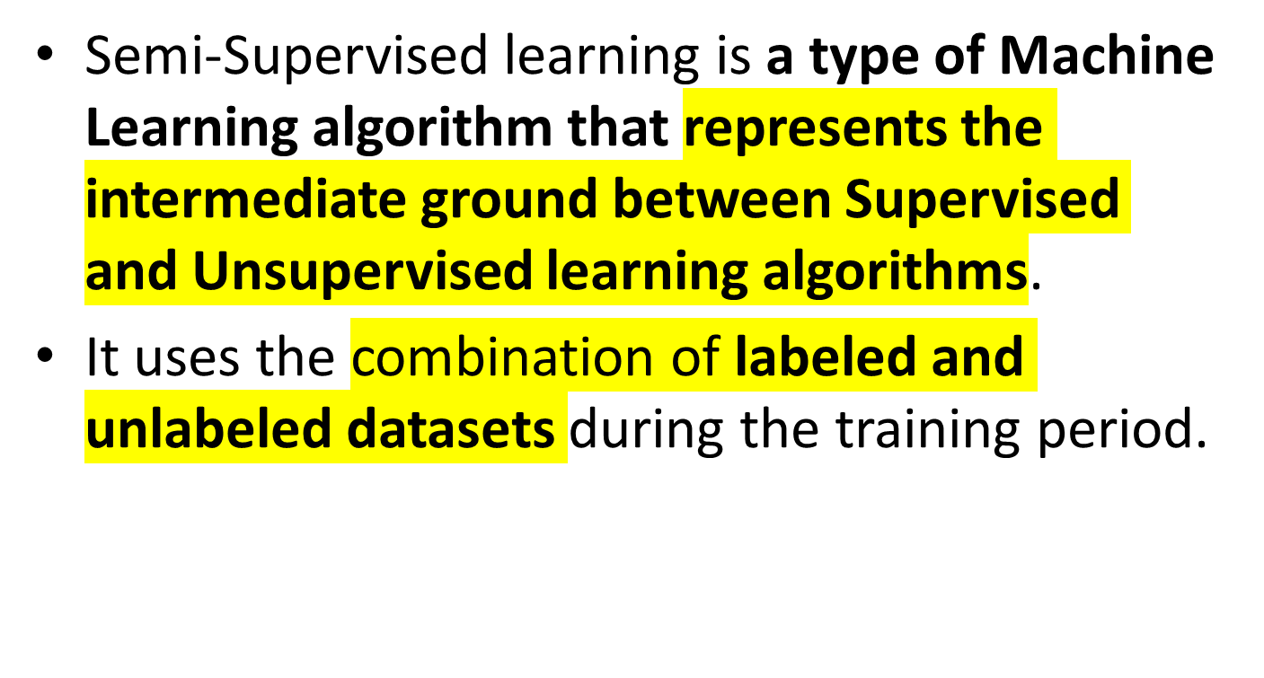
© Prof. Dr. A K M Akhtar Hossain Dept. of CSE, RU

Slide 33

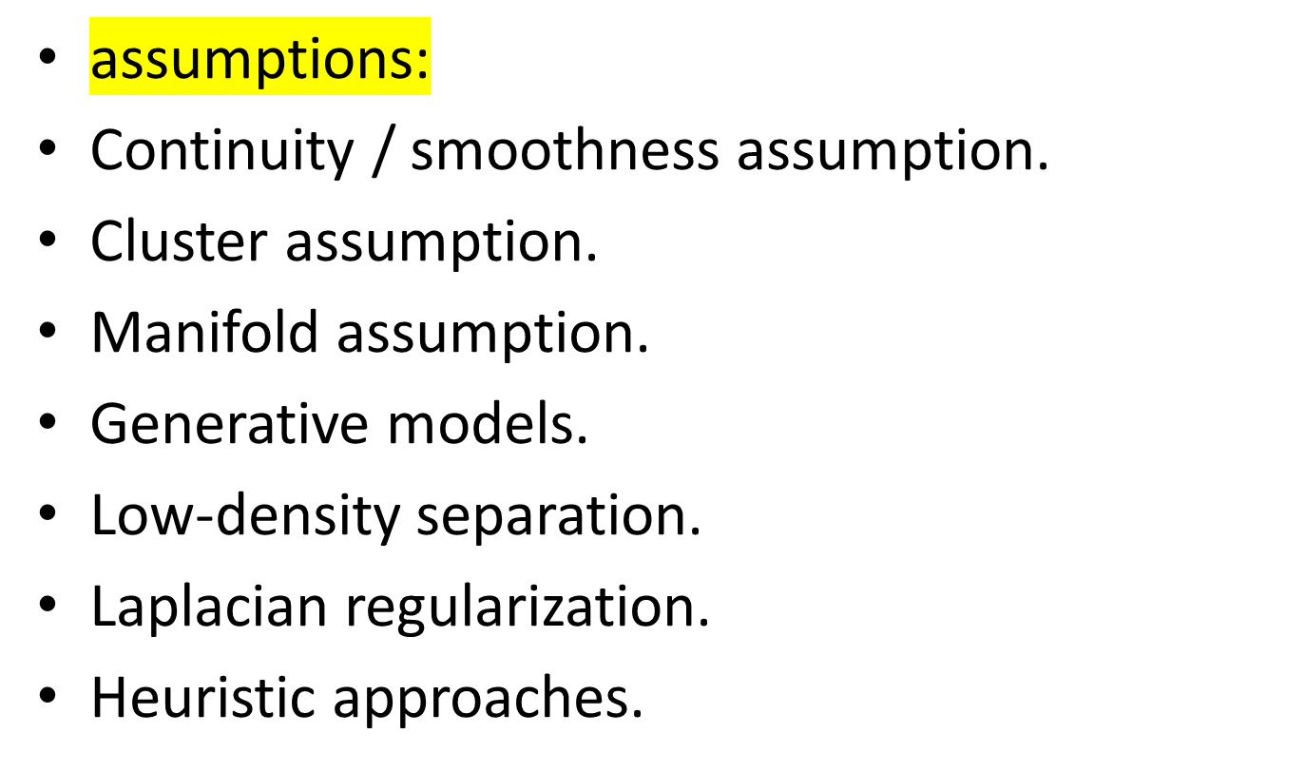
© Prof. Dr. A K M Akhtar Hossain Dept. of CSE, RU

Slide 34

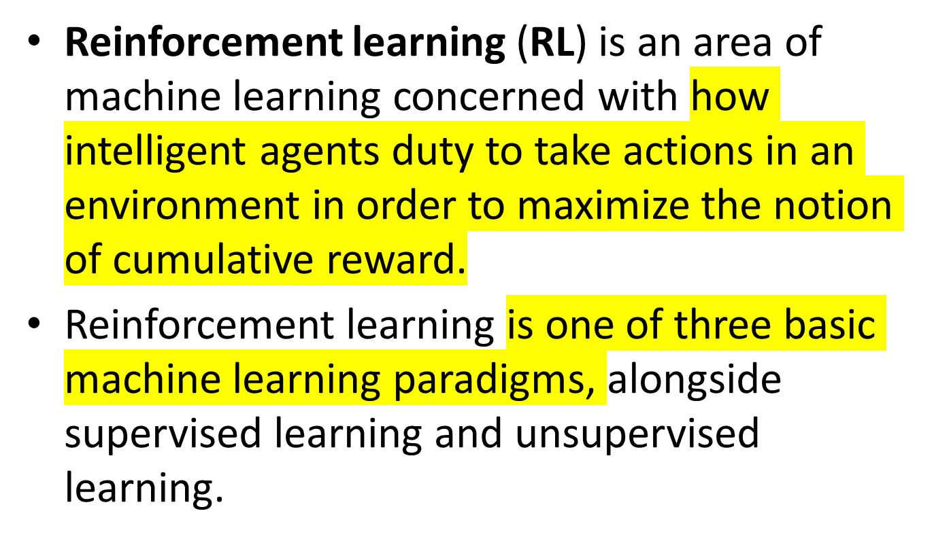
© Prof. Dr. A K M Akhtar Hossain Dept. of CSE, RU

Slide 35

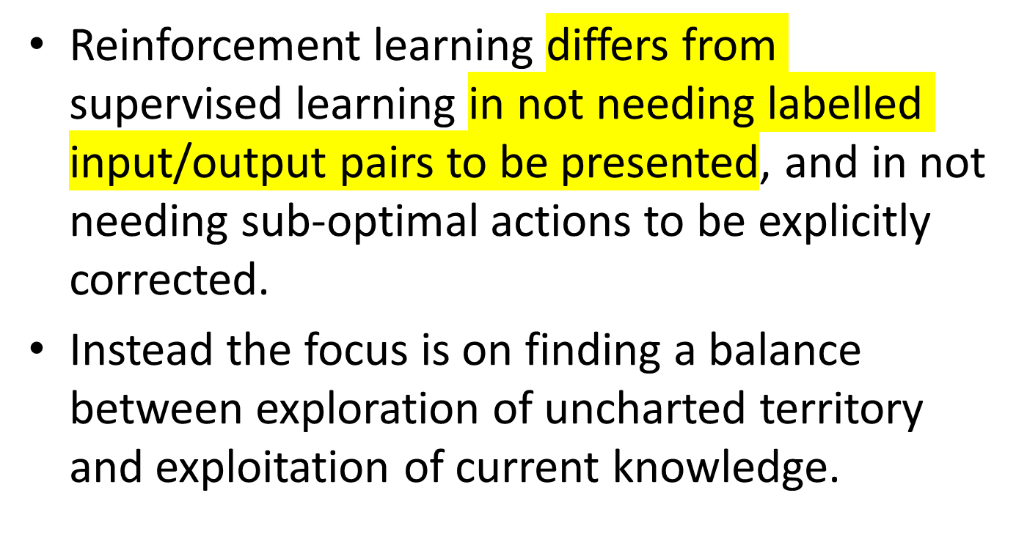
© Prof. Dr. A K M Akhtar Hossain Dept. of CSE, RU

Slide 36
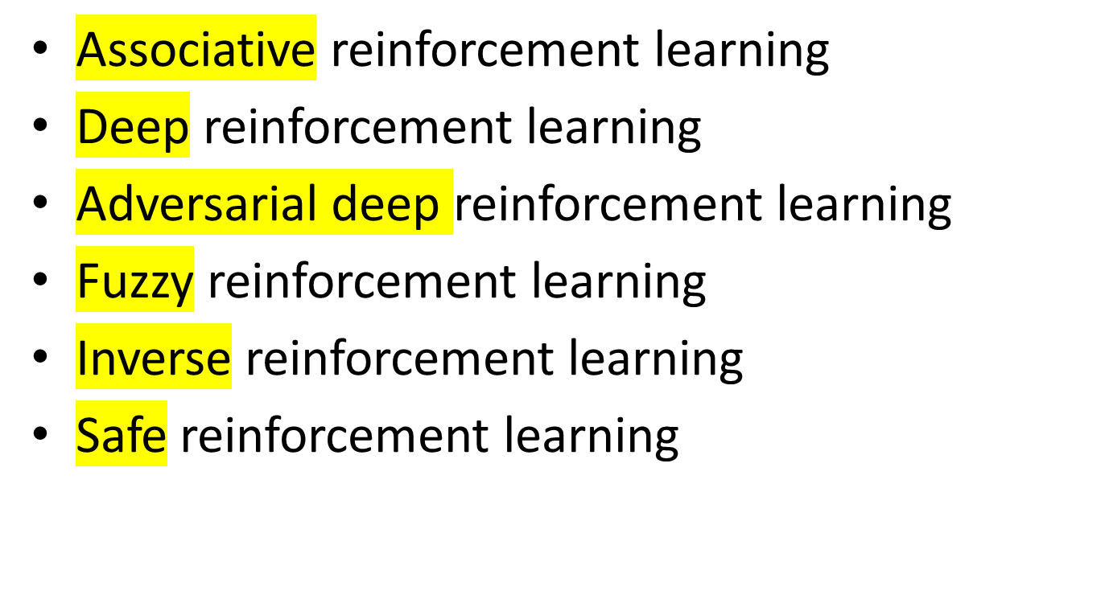
© Prof. Dr. A K M Akhtar Hossain Dept. of CSE, RU

Slide 37
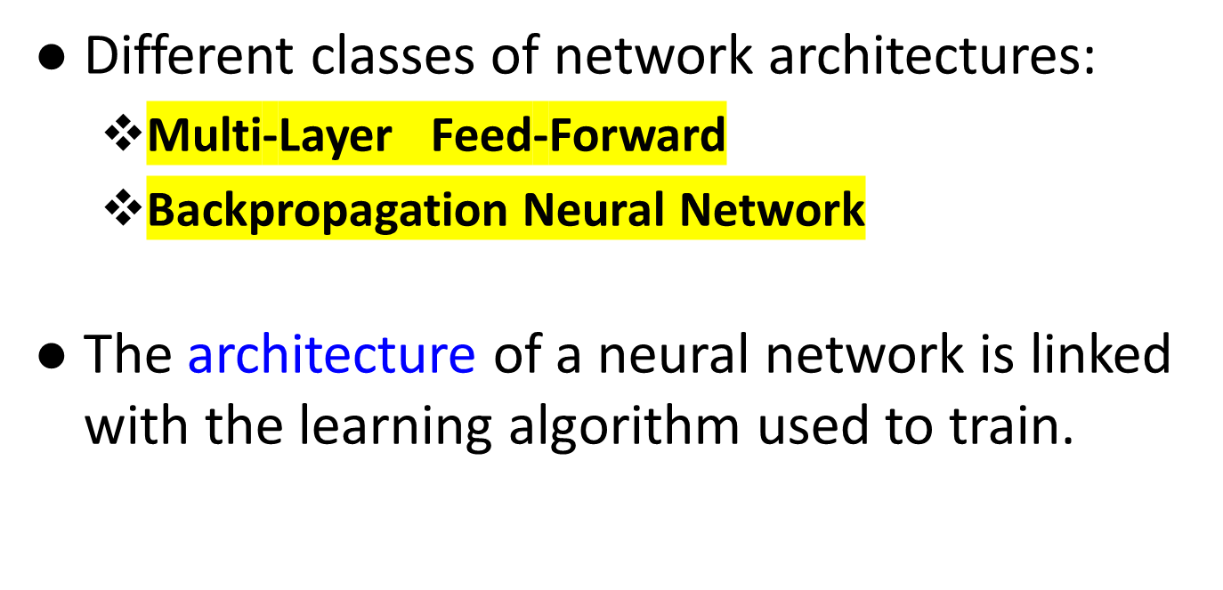
© Prof. Dr. A K M Akhtar Hossain Dept. of CSE, RU

Slide 38

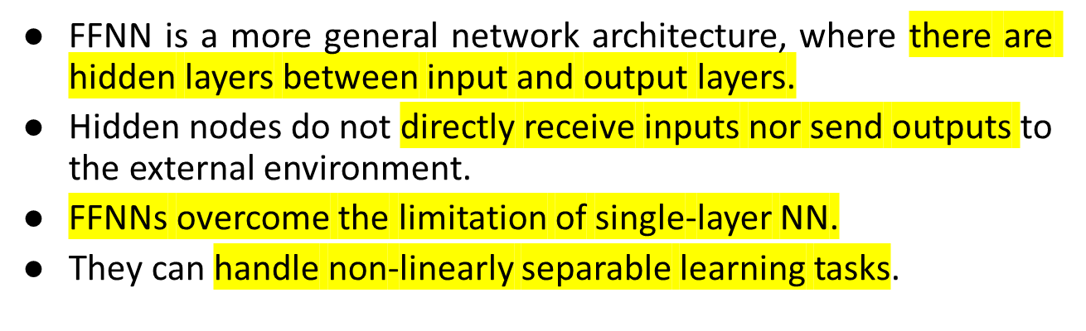
Input
layer
Output
layer
Hidden Layer
3-4-2 Network
© Prof. Dr. A K M Akhtar Hossain Dept. of CSE, RU

Slide 39
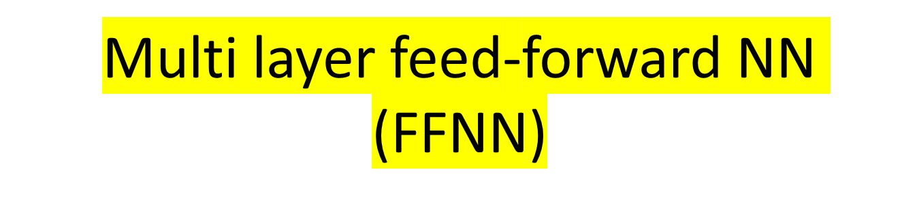

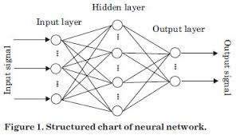
© Prof. Dr. A K M Akhtar Hossain Dept. of CSE, RU

Slide 40

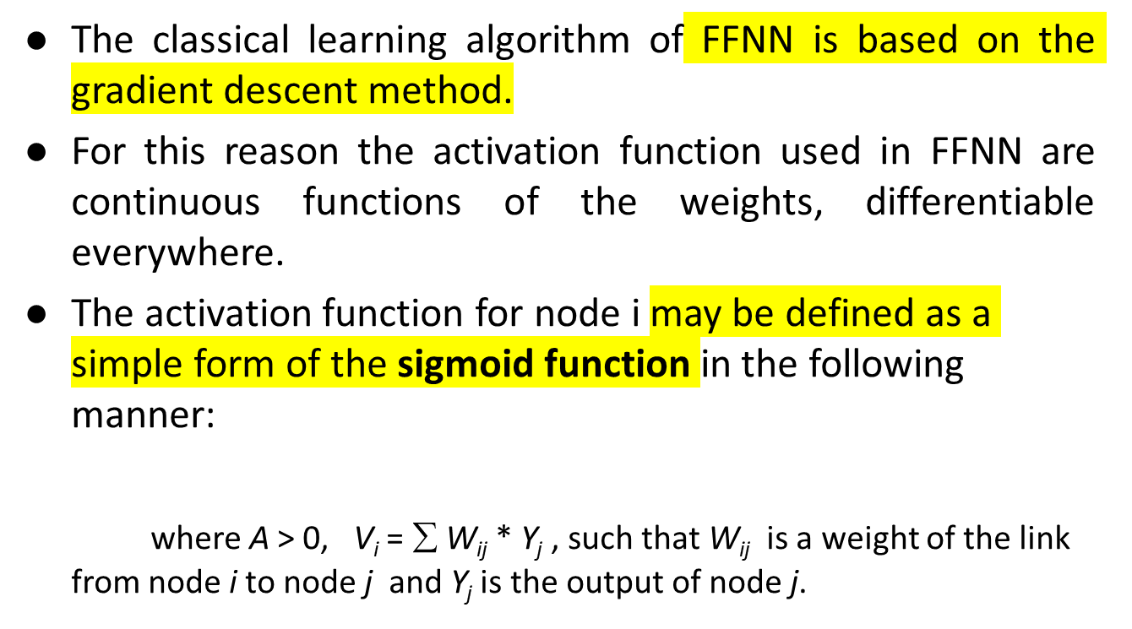
© Prof. Dr. A K M Akhtar Hossain Dept. of CSE, RU

Slide 41
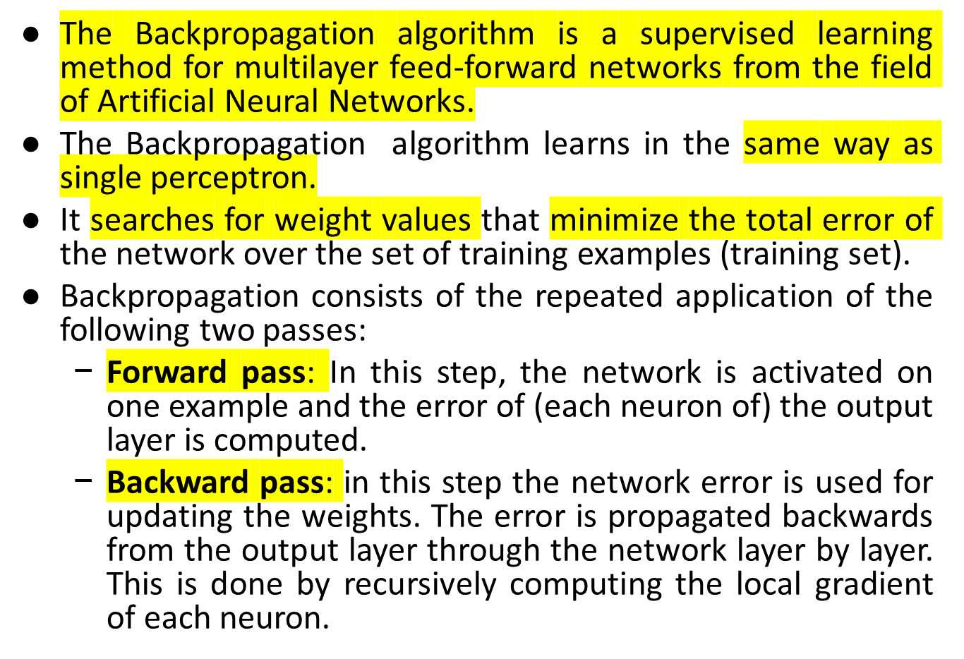
© Prof. Dr. A K M Akhtar Hossain Dept. of CSE, RU

Slide 42

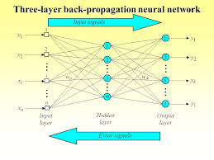
© Prof. Dr. A K M Akhtar Hossain Dept. of CSE, RU

Slide 43

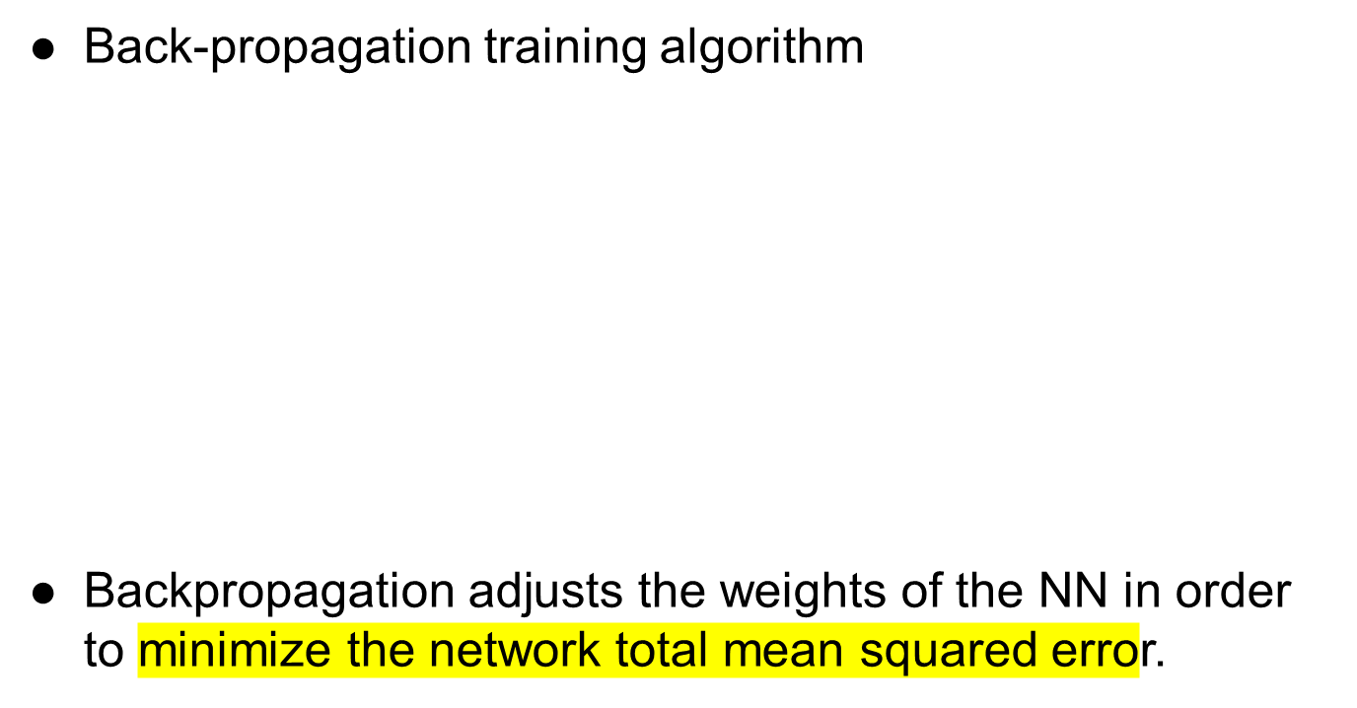
Network activation
Forward Step
Error propagation
Backward Step
© Prof. Dr. A K M Akhtar Hossain Dept. of CSE, RU

Slide 44
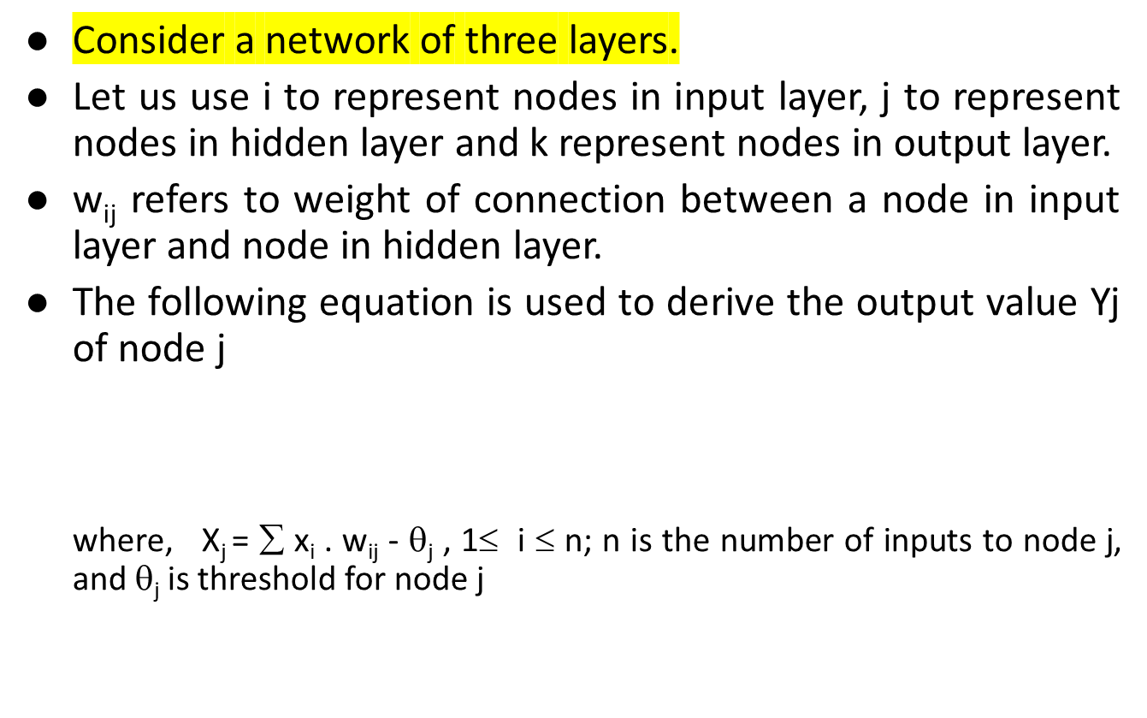
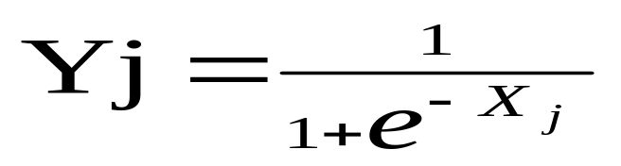
Contd..
© Prof. Dr. A K M Akhtar Hossain Dept. of CSE, RU

Slide 45

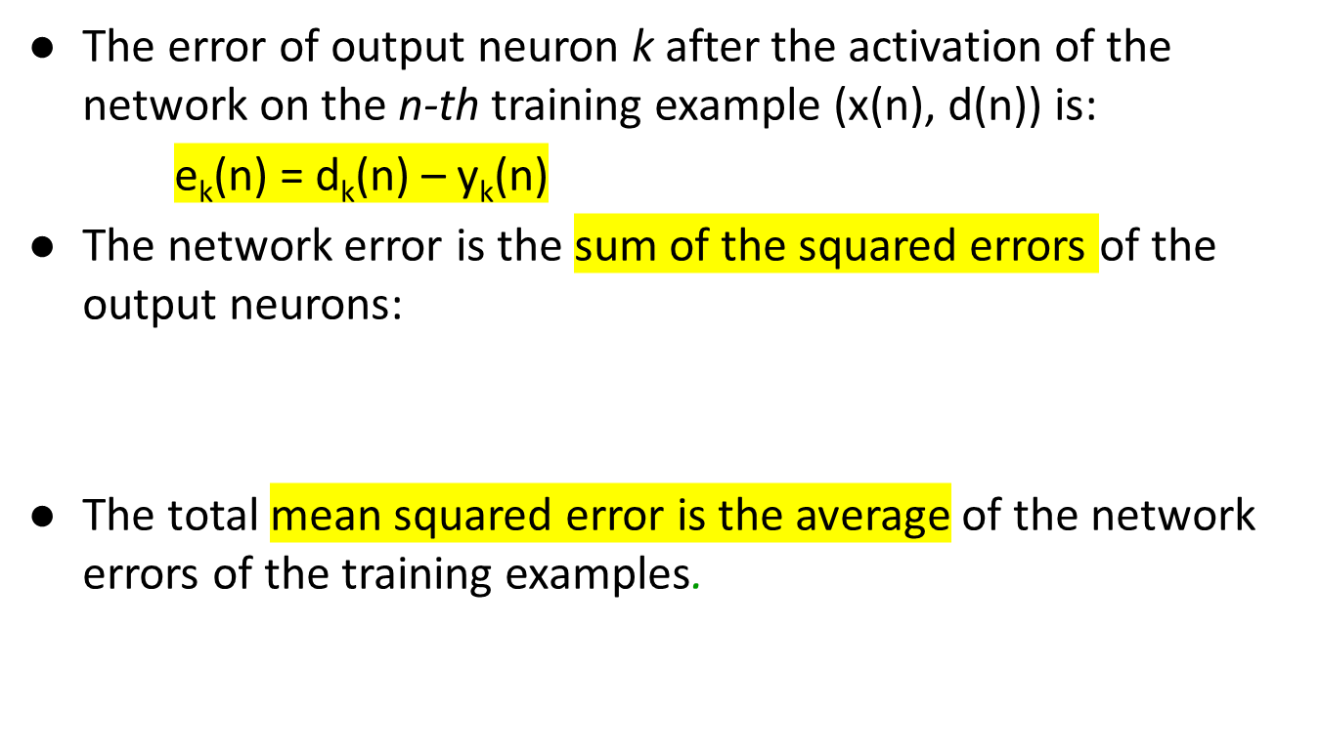


© Prof. Dr. A K M Akhtar Hossain Dept. of CSE, RU

Slide 46




© Prof. Dr. A K M Akhtar Hossain Dept. of CSE, RU

Slide 47



n=1;
initialize weights randomly;
while (stopping criterion not satisfied or n <max_iterations)
  for each example (x,d)
  - run the network with input x and compute the output y
  - update the weights in backward order starting from those of the output layer:
  with computed using the (generalized) Delta rule
  end-for
n = n+1;
end-while;
© Prof. Dr. A K M Akhtar Hossain Dept. of CSE, RU

Slide 48


© Prof. Dr. A K M Akhtar Hossain Dept. of CSE, RU

Slide 49


© Prof. Dr. A K M Akhtar Hossain Dept. of CSE, RU

Slide 50



In the hidden layer, each PE(Processing Element) or neuron computed the weighted sum according to the equation, which is given by
(1)
Where O_{ai} is the input of unit i for pattern number a. The threshold, uh_{j} of each PE is then added to its weighted sum to obtain the activation active_{j} of that PE i,e,
(2)
Where uh_{j} is the hidden threshold weight for jth PEs.
© Prof. Dr. A K M Akhtar Hossain Dept. of CSE, RU

Slide 51



© Prof. Dr. A K M Akhtar Hossain Dept. of CSE, RU

Slide 52
Input Patterns→
X[a][0]
X[a][1]
.
.
.
.
X[a][63]
T[a][0]
T[a][4]
W_{ij}
k₁
η₁
W_{jk}
k₂
η₂
i =Input
Layer
j = Hidden
layer
k= Output
layer
Fig.12.7 BackPropagation Neural Network
© Prof. Dr. A K M Akhtar Hossain Dept. of CSE, RU

Slide 53


(4)
and the output threshold weight uo_{k} for k-th output neuron is added to it to find out the activation active_{(k)}
(5)
The actual output O_{ak} is computed using the same sigmoid function,
© Prof. Dr. A K M Akhtar Hossain Dept. of CSE, RU

Slide 54


(6)
Here another spread factor k₂ has been employed for the output units.
In the second stage, after completing the feed‑forward propagation, an error is computed by comparing the output O_{ak} with the respective target t_{ak} ,i.e
(7)
© Prof. Dr. A K M Akhtar Hossain Dept. of CSE, RU

Slide 55


This error is then used to adjust the weight vector using the equation,
(8)
Where,
the derivation of sigmoid function and is the learning factor of the network.
© Prof. Dr. A K M Akhtar Hossain Dept. of CSE, RU

Slide 56




The weight vector is then adjusted to
. For the threshold weight of the output PE, similar equation is applied,
(9)
and the new threshold weight equaled
© Prof. Dr. A K M Akhtar Hossain Dept. of CSE, RU

Slide 57




In the next step, this error and the adjusted weight vector are feedback to the hidden layer to adjust the weight vector and threshold weight uh_{j.} In this layer change in weight vector is computed by using equation,
(10)
Where, and is the learning factor of the network.
© Prof. Dr. A K M Akhtar Hossain Dept. of CSE, RU

Slide 58



The weight vector W_{ij} is then adjusted to
.
For the threshold weights of the hidden PEs, similar equation is applied
(11)
and new threshold weights are calculated
© Prof. Dr. A K M Akhtar Hossain Dept. of CSE, RU

Slide 59

© Prof. Dr. A K M Akhtar Hossain Dept. of CSE, RU

Slide 60

Example for Training
© Prof. Dr. A K M Akhtar Hossain Dept. of CSE, RU

Slide 61

© Prof. Dr. A K M Akhtar Hossain Dept. of CSE, RU

Slide 62

© Prof. Dr. A K M Akhtar Hossain Dept. of CSE, RU

Slide 63

© Prof. Dr. A K M Akhtar Hossain Dept. of CSE, RU

Slide 64

© Prof. Dr. A K M Akhtar Hossain Dept. of CSE, RU

Slide 65

© Prof. Dr. A K M Akhtar Hossain Dept. of CSE, RU

Slide 66


© Prof. Dr. A K M Akhtar Hossain Dept. of CSE, RU

Slide 67
Recurrent Neural Network (RNN)
RNN works on the principle of saving the output of a particular layer and feeding this back to the input in order to predict the output of the layer.
In below figure shows how toconvert a Feed-Forward Neural Network into a Recurrent Neural Network:
© Prof. Dr. A K M Akhtar Hossain Dept. of CSE, RU

Slide 68


© Prof. Dr. A K M Akhtar Hossain Dept. of CSE, RU

Slide 69
The nodes in different layers of the neural network are compressed to form a single layer of recurrent neural networks. A, B, and C are the parameters of the network.
© Prof. Dr. A K M Akhtar Hossain Dept. of CSE, RU

Slide 70

© Prof. Dr. A K M Akhtar Hossain Dept. of CSE, RU

Slide 71
Recurrent Neural Network (RNN)
Here, “x” is the input layer, “h” is the hidden layer, and “y” is the output layer.
A, B, and C are the network parameters used to improve the output of the model.
At any given time t, the current input is a combination of input at x(t) and x(t-1).
The output at any given time is fetched back to the network to improve on the output.
© Prof. Dr. A K M Akhtar Hossain Dept. of CSE, RU

Slide 72

Recurrent Neural Network (RNN)
© Prof. Dr. A K M Akhtar Hossain Dept. of CSE, RU

Slide 73

Recurrent Neural Network (RNN)
© Prof. Dr. A K M Akhtar Hossain Dept. of CSE, RU

Slide 74

How Does Recurrent Neural Networks Work?
© Prof. Dr. A K M Akhtar Hossain Dept. of CSE, RU

Slide 75

The input layer ‘x’ takes in the input to the neural network and processes it and passes it onto the middle layer.
The middle layer ‘h’ can consist of multiple hidden layers, each with its own activation functions and weights and biases.
If you have a neural network where the various parameters of different hidden layers are not affected by the previous layer, ie: the neural network does not have memory, then you can use a recurrent neural network.
© Prof. Dr. A K M Akhtar Hossain Dept. of CSE, RU

Slide 76

© Prof. Dr. A K M Akhtar Hossain Dept. of CSE, RU

Slide 77
References
https://mattmazur.com/2015/03/17/a-step-by-step-backpropagation-example/
https://www.youtube.com/watch?v=GJXKOrqZauk
https://www.youtube.com/watch?v=0e0z28wAWfg
© Prof. Dr. A K M Akhtar Hossain Dept. of CSE, RU

Slide 78
THE END
© Prof. Dr. A K M Akhtar Hossain Dept. of CSE, RU

